Slide 1
Data Encoding Fundamentals

Slide 2
Visual Attributes
Important things to consider before making design decisions
Who is your audience?
What is the purpose of your visualization?
How many variables do you have?
Have you looked at the data?
Is it clean? Are there potentially erroneous data?
What types of data are your variables?
Quantitative
Fixed zero (ratio)? (e.g., mass, $)
Zero arbitrary (interval)? (e.g., date, long/lat)
Ordinal (e.g., grades)
Nominal (apples & oranges)

Slide 3
Visual Attributes
Previous work has developed suggested “best practices” for encoding data
Based on
Theory (psychology, human perception)
Research
Experience
Playfair, Tukey, Bertin, Cleveland & McGill, Few, Schniederman, Mackinlay, Card, Heer & Bostock, etc.

Slide 4
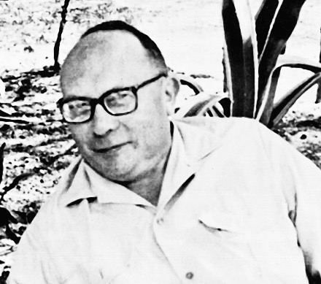
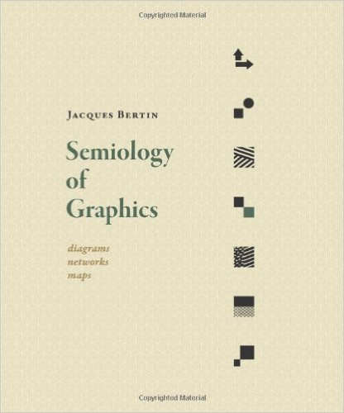
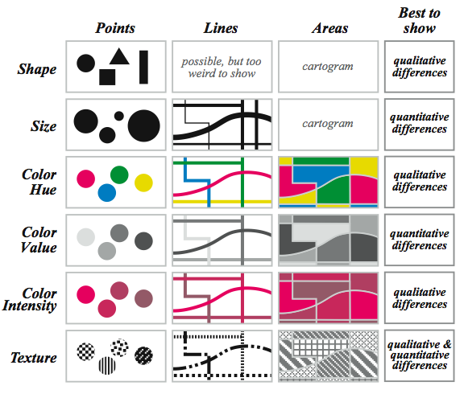
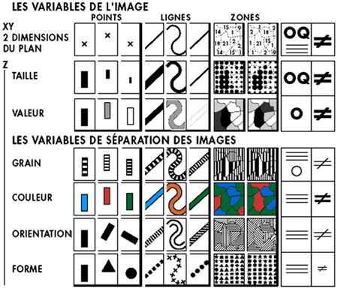
Bertin
Based on theory & experience
Bertin, Jacques. Semiology of Graphics: Diagrams, Networks, Maps. Madison, WI: University of Wisconsin Press, 1983.
Notes:
Theoretical, based on

Slide 5


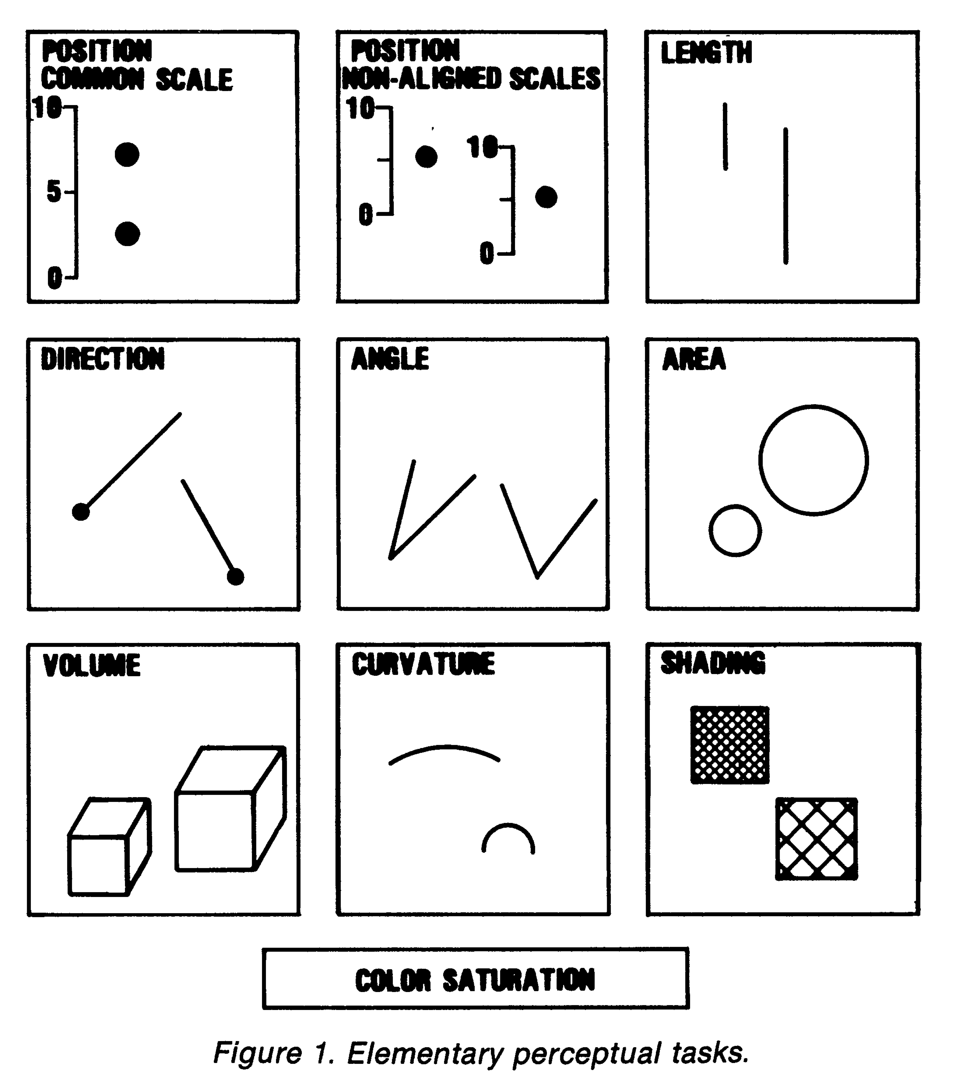
Cleveland & McGill
Based on research & theory
More accurate
Less accurate
WS Cleveland, R McGill. Graphical perception: Theory, experimentation, and application to the development of graphical methods. Journal of the American statistical association. 1984;79(387):531-554.
Notes:
Experimental

Slide 6

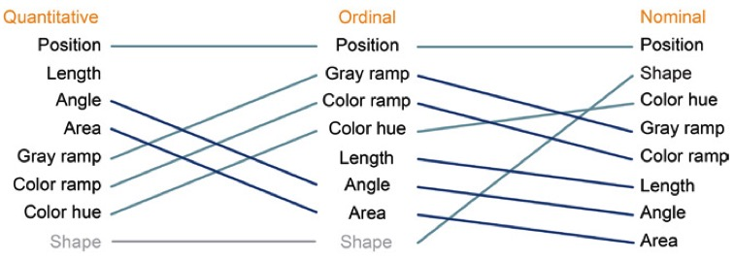
Mackinlay
Based on research & theory
More accurate
Less accurate
Mackinlay & Winslow. Designing Great Visualizations
http://www.tableau.com/sites/default/files/media/designing-great-visualizations.pdf
Mackinlay. Automating the design of graphical presentations of relational information. Acm Transactions On Graphics. 1986;5(2):110-141.
Notes:
Research needed to empirically test

Slide 7
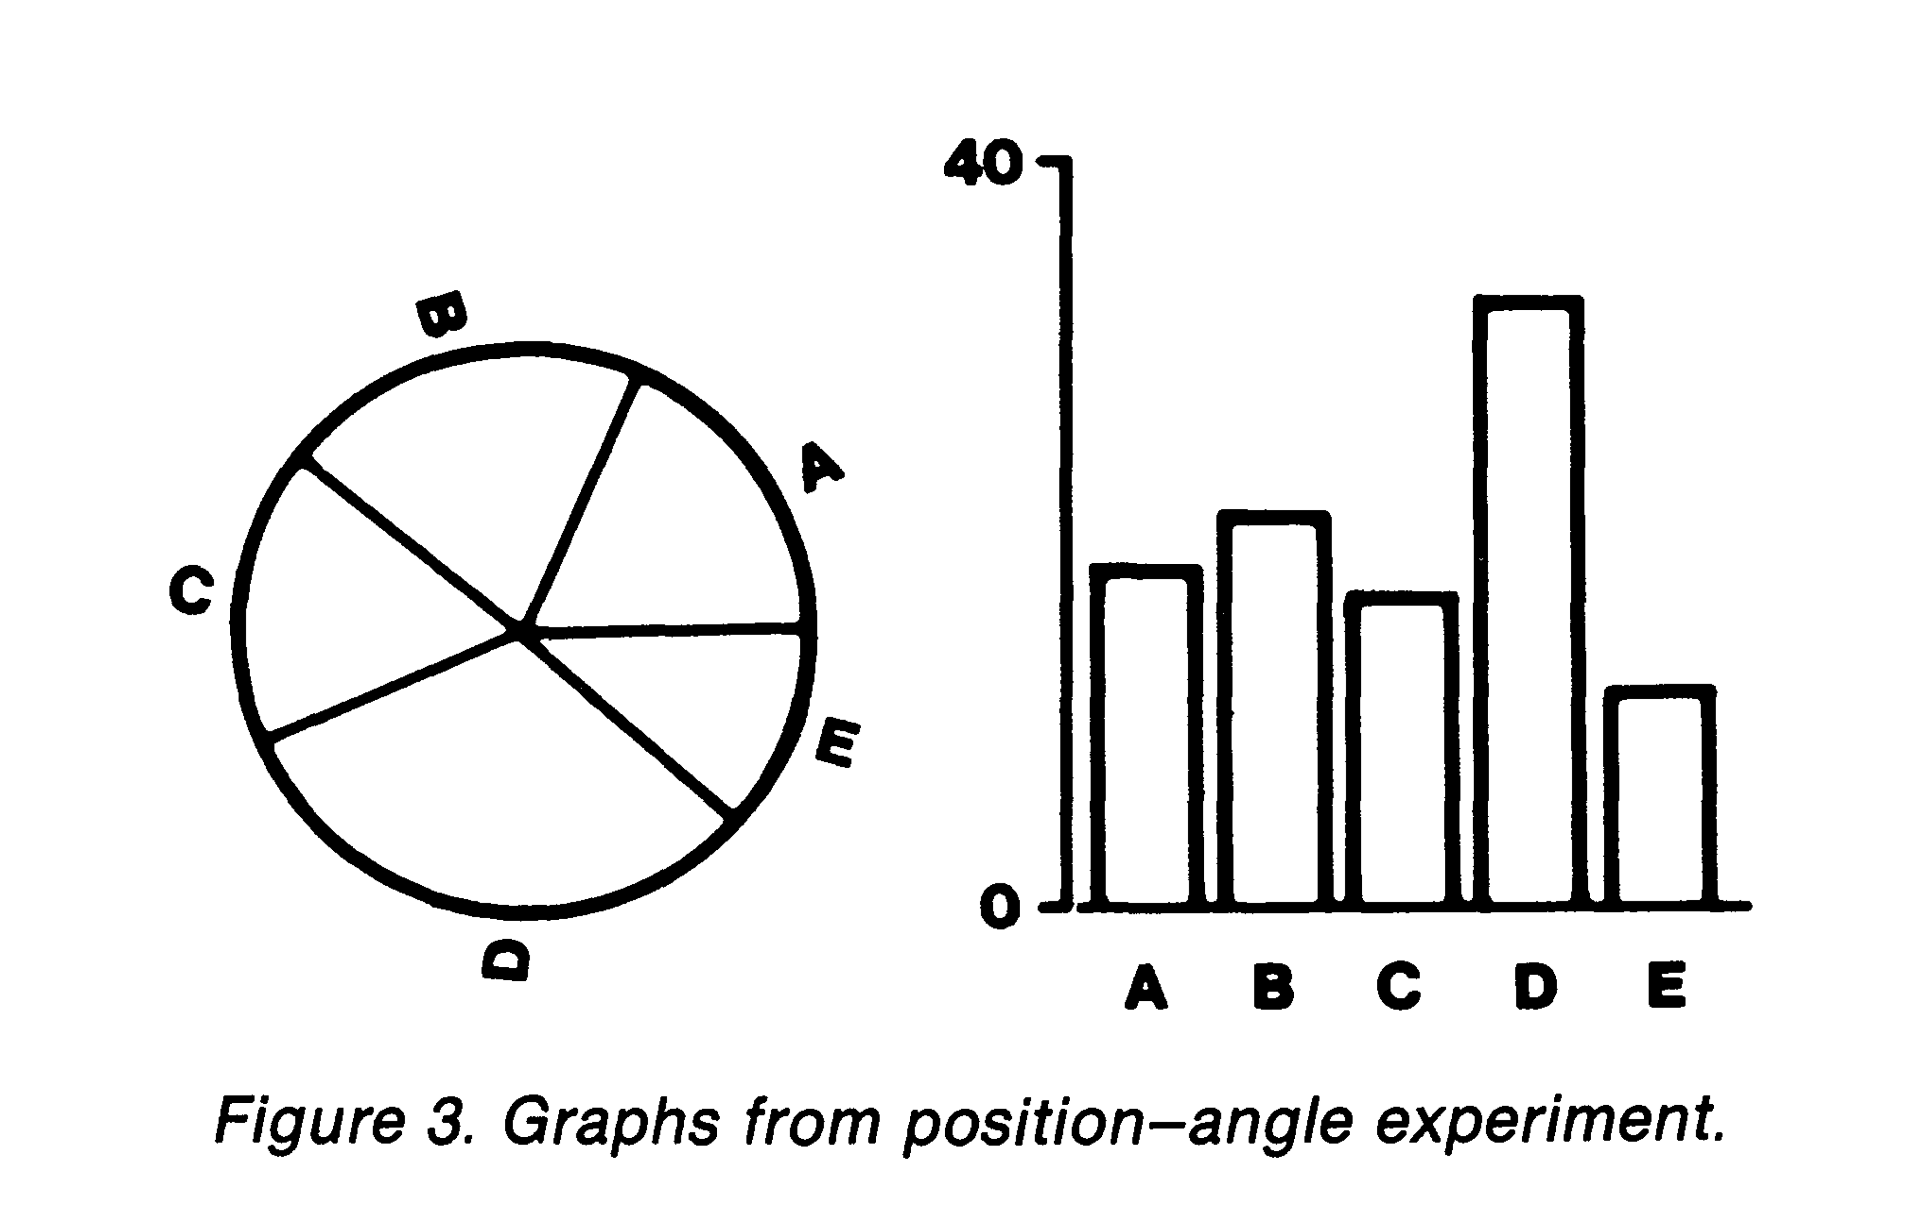
There are 5 quantitative values labeled A-E Is A bigger than C?
WS Cleveland, R McGill. Graphical perception: Theory, experimentation, and application to the development of graphical methods. Journal of the American statistical association. 1984;79(387):531-554.
Mackinlay & Winslow Designing Great Visualizations
http://www.tableau.com/sites/default/files/media/designing-great-visualizations.pdf

Slide 8
The Science Behind Optimal Encoding
Cleveland & McGill
Most accurate
Least accurate
WS Cleveland, R McGill. Graphical perception: Theory, experimentation, and application to the development of graphical methods. Journal of the American statistical association. 1984;79(387):531-554.

Slide 9
Cleveland & McGill
Methods
n=55
Participants “fell into 2 categories”
Females, “mostly housewives, without substantial training & working in technical jobs”
Males & females “with substantial training & working in technical jobs”
Assessed position-angle then position-length graphs

Slide 10
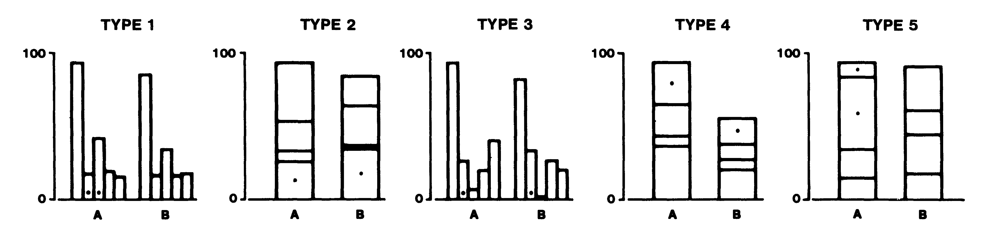
Cleveland & McGill
Common scale
Position-length
Participants judged
Which dotted bar was smaller
what percent the smaller dotted bar is of the larger dotted bar

Slide 11
Cleveland & McGill
Angle
Length
Participants judged
Which slice/bar segment was largest
The percentages of the smaller slices/bar segments

Slide 12
Cleveland & McGill
Analyses
Accuracy
Large absolute errors
Mean of errors
You can check the paper to see the equations used to calculate these

Slide 13
Cleveland & McGill
Findings
No differences in accuracy by technical experience
Position judgments
1.4 - 2.5x more accurate than length judgments
~2x more accurate than angle judgments

Slide 14


Heer (@UW CSE) & Bostock
Recent build onto Cleveland & McGill’s work
Used mTurk to assess proportional judgment tasks from Cleveland & McGill + circular area
Also tested
Rectangular area judgment
Other things I won’t cover here (e.g., gridline spacing)

Slide 15
Heer & Bostock
Methods
Proportional judgment experiment
n=50
ID’d the smaller of two marked values & estimated what % the smaller was of the larger
Analyses same equations as Cleveland & McGill

Slide 16
Heer & Bostock
Methods
Rectangular judgment
n=24
ID’d the smaller of two marked rectangles & estimated what % the smaller was of the larger
Analyses same equations as Cleveland & McGill

Slide 17
Heer & Bostock
Findings
Bar > stacked bar > pie > bubble/treemap

Slide 18
The Science Behind Optimal Encoding
More research is needed to validate previous research
Are findings universal?
Generalizability?
Are there particulars in biomedical & health informatics where these findings may not apply?
Stakes higher, users vary (clinicians, researchers, patients), purposes vary (e.g., point-of care instant decision-making aids, developing prediction models, daily health management)

Slide 19
Summary
Important things to consider before making design decisions
There is guidance on “best practices” for how to encode data
More research is needed to validate “best practices” especially in biomedical & health informatics

